Slide 1
Building Single Page Applications with AEM
Brendan Robert | Sr. Technical Architect – ACS Emerging Technologies

Slide 2
1 | Welcome and Overview
2 | Choose Your Track
3 | Highlight Reel
4 | Summary and Conclusion

Slide 3

Welcome!
We have assembled a team who will help you:
Discover the integration of single-page application frameworks, such as Angular and React with Experience Manager
Review the improved authoring features provided by new in-context editing support in Experience Manager 6.4
Explore implementation of front-end and externally-managed experiences that leverage the content service features of Experience Manager
And more!

Slide 4
1 | Welcome and Overview
2 | Choose Your Track
3 | Highlight Reel
4 | Summary and Conclusion

Slide 5

Choose your Track
This lab is structured around a wide range of topics, some of which are more relevant to your needs than others. These are listed on page 3 of the lab workbook.
Not everyone here is a developer, and that’s okay! Take the Feature Tour.
Developers who prefer more of the front-end and little or no AEM might better appreciate the Front-End Developer Track.
AEM and other full-stack developers will likely be interested in all the content, but there is also an alternate Code-centric Tour that gets you elbows-deep in code faster than the numeric ordering.
Try to budget your time to tackle more challenging
things while you are here. That will help maximize
your time with our staff to help you though trickier
topics or other related questions.

Slide 6
Lab tracks – Part 1
Feature | Front-End Dev | Full-Stack | Code-Centric
Exercise 1 | Exercise 1 | Exercise 1 | Exercise 1
Exercise 2 | Exercise 2 (Optional) | Exercise 2 | Exercise 13
Exercise 3 | Exercise 3 | Exercise 3 | Exercise 14
 |  |  | Exercise 2
 |  |  | Exercise 3

Slide 7
Lab tracks – Part 1
Feature | Front-End Dev | Full-Stack | Code-Centric
Exercise 1 | Exercise 1 | Exercise 1 | Exercise 1
Exercise 2 | Exercise 2 (Optional) | Exercise 2 | Exercise 13
Exercise 3 | Exercise 3 | Exercise 3 | Exercise 14
 |  |  | Exercise 2
 |  |  | Exercise 3

Slide 8
Lab tracks – Part 2
Feature | Front-End Dev | Full-Stack | Code-Centric
Exercise 4 | Exercise 4 | Exercise 4 | Exercise 4
Exercise 5 | Exercise 5 | Exercise 5 | Exercise 5
Exercise 6 | Exercise 6 | Exercise 6 | Exercise 16
Exercise 8 | Exercise 7 | Exercise 7 | Exercise 6
 | Exercise 8 | Exercise 8 | Exercise 7
 |  |  | Exercise 8

Slide 9
Lab tracks – Part 2 Review
Feature | Front-End Dev | Full-Stack | Code-Centric
Exercise 4 | Exercise 4 | Exercise 4 | Exercise 4
Exercise 5 | Exercise 5 | Exercise 5 | Exercise 5
Exercise 6 | Exercise 6 | Exercise 6 | Exercise 16
Exercise 8 | Exercise 7 | Exercise 7 | Exercise 6
 | Exercise 8 | Exercise 8 | Exercise 7
 |  |  | Exercise 8

Slide 10
Lab tracks – Part 3
Feature | Front-End Dev | Full-Stack | Code-Centric
Exercise 11 | Exercise 9 | Exercise 9 | Exercise 11
Exercise 12 | Exercise 10 | Exercise 10 | Exercise 12
 | Exercise 11 | Exercise 11 | Exercise 9
 |  | Exercise 12 | Exercise 17
 |  | Exercise 13 | Exercise 10
 |  | Exercise 14

Slide 11
1 | Welcome and Overview
2 | Choose Your Track
3 | Highlight Reel
4 | Summary and Conclusion

Slide 12
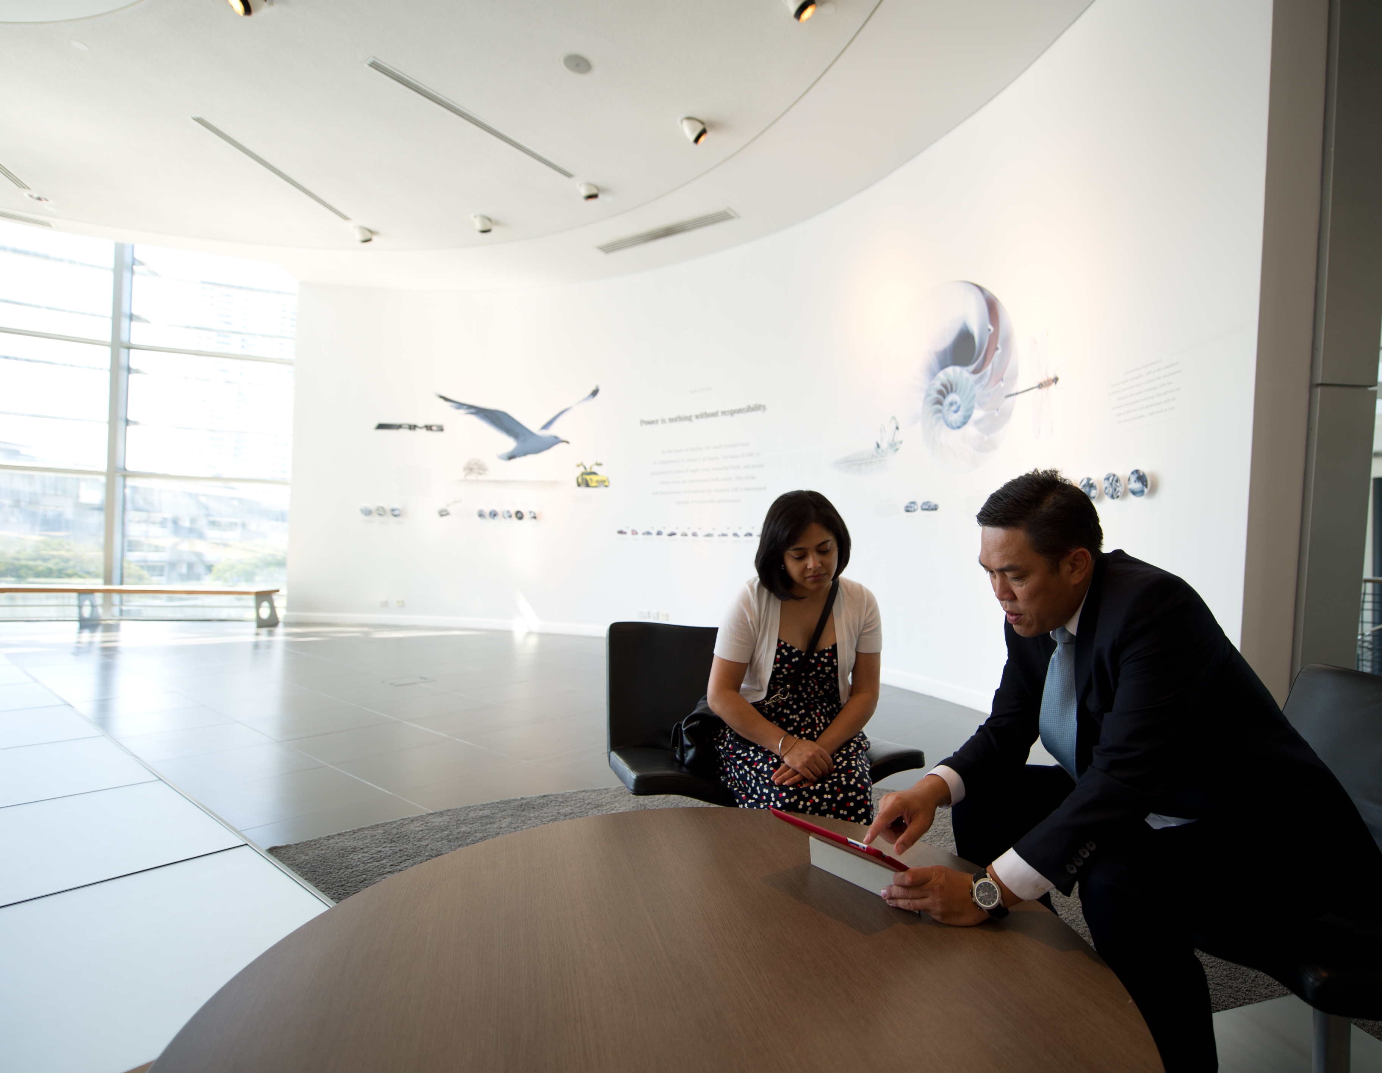
Highlights
Definitely don’t skip out on these exercises:
Exercise 11 is a preview of an upcoming feature pack. This is an exclusive opportunity to get a sneak-peek and get a head-start on something nobody else has seen yet.
Exercises 2 and 3 are good primers for new AEM 6.4 functionality related to content fragments.
Exercises 13 and 14 should be followed before doing any of the later code-related exercises.
Exercises 18 and 19 are advanced developer topics that full-stack and AEM developers might want to budget time to review while here.

Slide 13
Lab tracks – Part 3 Review
Feature | Front-End Dev | Full-Stack | Code-Centric
Exercise 11 | Exercise 9 | Exercise 9 | Exercise 11
Exercise 12 | Exercise 10 | Exercise 10 | Exercise 12
 | Exercise 11 | Exercise 11 | Exercise 9
 |  | Exercise 12 | Exercise 17
 |  | Exercise 13 | Exercise 10
 |  | Exercise 14

Slide 14
Lab tracks – Part 4
Feature | Front-End Dev | Full-Stack | Code-Centric
Exercise 9 | Exercise 13 | Exercise 15 | Exercise 15
Exercise 10 | Exercise 14 | Exercise 16 | Exercise 18
Exercise 18 | Exercise 15 | Exercise 17 | Exercise 19
 | Exercise 16 | Exercise 18
 | Exercise 17 | Exercise 19
 | Exercise 19

Slide 15
Lab tracks – Part 4 Review
Feature | Front-End Dev | Full-Stack | Code-Centric
Exercise 9 | Exercise 13 | Exercise 15 | Exercise 15
Exercise 10 | Exercise 14 | Exercise 16 | Exercise 18
Exercise 18 | Exercise 15 | Exercise 17 | Exercise 19
 | Exercise 16 | Exercise 18
 | Exercise 17 | Exercise 19
 | Exercise 19

Slide 16
1 | Welcome and Overview
2 | Choose Your Track
3 | Highlight Reel
4 | Summary and Conclusion

Slide 17
Summit 2018 GitHub Repo
https://github.com/Adobe-Marketing-Cloud/Summit2018
Branch L737

Slide 18
Brendan Robert
brendan@adobe.com
Twitter: @brendan_robert

Slide 19




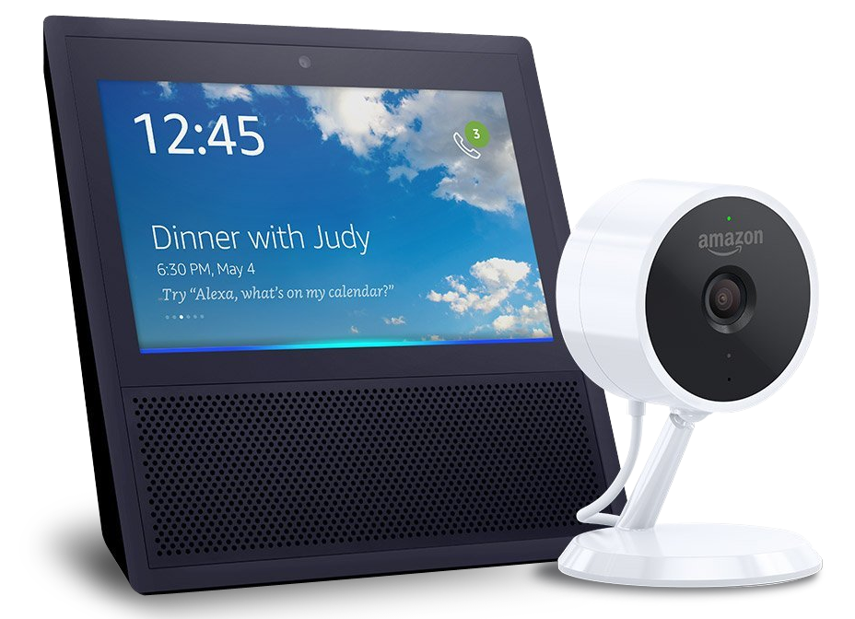
Take the Survey to win!
(Survey section of the mobile app)
SESSION PRIZE
one per session
$10
Starbucks
Card
DAY 1
DAY 2
DAY 3
Bash Experience
Signed football helmet
Amazon Echo Show & Cloud Cam Bundle

Slide 20


JOIN US IN THE COMMUNITY PAVILION
Get your SUMMIT SELFie!. Share with friends, earn badges, and win prizes.
Talk with our
Experience Experts from Services & Learning.
See live speaker sessions at the Experience Theater.
Notes:
EP to present

